Slide 1
Understanding the Identity Business (and how to get out of it)
Jeff Putz

Slide 2



About me
Cleveland, then Seattle, now The OC, Florida °o°
Been in software development for 20+ years
Ready for a midlife crisis (on my second Tesla)
Currently VP of Engineering at PowerDMS
Past credits include Microsoft, Insurance.com, Humana, startups
Maintains POPWorldMedia/POPForums on GitHub
Blog: jeffputz.com
jeffputz jeffputz jeff.putz

Slide 3

SELFIE TAKEN AT CLE AFTER GETTING OFF THE PLANE

Slide 4


Slide 5
Agenda
I’m not an expert, but I am a decision maker.
We’re going to go over the basics of identity management.
Review identity in the context of monolithic and microservice architectures.
Look harder at OAuth2, and demonstrate live exchanges of data!
The levels from building a thing to not building a thing.
Pros and cons (so many cons) of rolling your own things.

Slide 6
What is identity management?
The process and technology around identifying users of a system, and what they’re allowed to mess with.
An identity provider is an atomic system that you access to learn about the identity of a user.

Slide 7
The person and the claims
The person is identified by a unique identifier. This is your “foreign key,” so to speak, that you may reference in your app. The ID is a claim.
Claims are a set of attributes that describe what the person is, not what they can do.
Claims can be anything… name, email, age, favorite color, rank, etc.
Do not confuse this with role. Identity providers are not in the business of determining what a person can do.

Slide 8
Authentication vs. Authorization
Authentication is the process of confirming identity.
Authorization is the process of determining whether that identity has access.
Identity providers do not determine authorization… that’s left to the consuming application. However, you typically can’t access a resource without authenticating.
It’s not uncommon to require more of the user once you’ve confirmed who they are.

Slide 9
Monolithic identity
Application
UI
User Data
Business Logic
Background Services

Slide 10
Non-monolithic identity
UX
Order Service
Server App/
Orchestration Service
Customer Metadata Service
Identity Service
Invoice Mailing Service
Identity Database

Slide 11
Protocol games
Not an exhaustive list, but…
SAML (Security Assertion Markup Language)
LDAP (Lightweight Directory Access Protocol, basis for AD)
OAuth2 (which is frequently used for authorization)
OpenID and OpenID Connect (supersets of OAuth2)
There is a lot to have deep knowledge about here to try and roll it all yourself. We’ll come back to that.
Notes:
SAML- enterprise giant, LDAP- popular in MSFT shops,

Slide 12
Digging in to OAuth2
We’ll do the server-side flow here, but know that the SPA flow typically involves an extra step to generate a client-side secret.
This is the Google OAuth2 server-side flow.
Google uses OpenID Connect.

Slide 13
Digging in to OAuth2
Send (GET) user to ID provider :
client_id: Comes from the Google developer console.
redirect_uri: Where to send the user back at your app. This URI has to be registered with Google, or it will protest.
response_type: “code,” which gives us something to interrogate Google with later.
state: Something you can validate later for the round-trip.
scope: A space delimited list of things we want to get back. For Google, we can ask for https://www.googleapis.com/auth/userinfo.email, for example.
https://accounts.google.com/o/oauth2/v2/auth?client_id=79916434881-dl8v6l9canurrtd8bc0d6bm87qo33qll.apps.googleusercontent.com&redirect_uri=https%3a%2f%2flocalhost%3a44353%2fhome%2fcallbackgoogle&state=d69bfca9c5b7fc1f72e02aafb9b06c5323d69ff5781c9a4ad16b748fdf200668&response_type=code&scope=https%3A%2F%2Fwww.googleapis.com%2Fauth%2Fuserinfo.email+https%3A%2F%2Fwww.googleapis.com%2Fauth%2Fuserinfo.profile+openid+email+profile

Slide 14
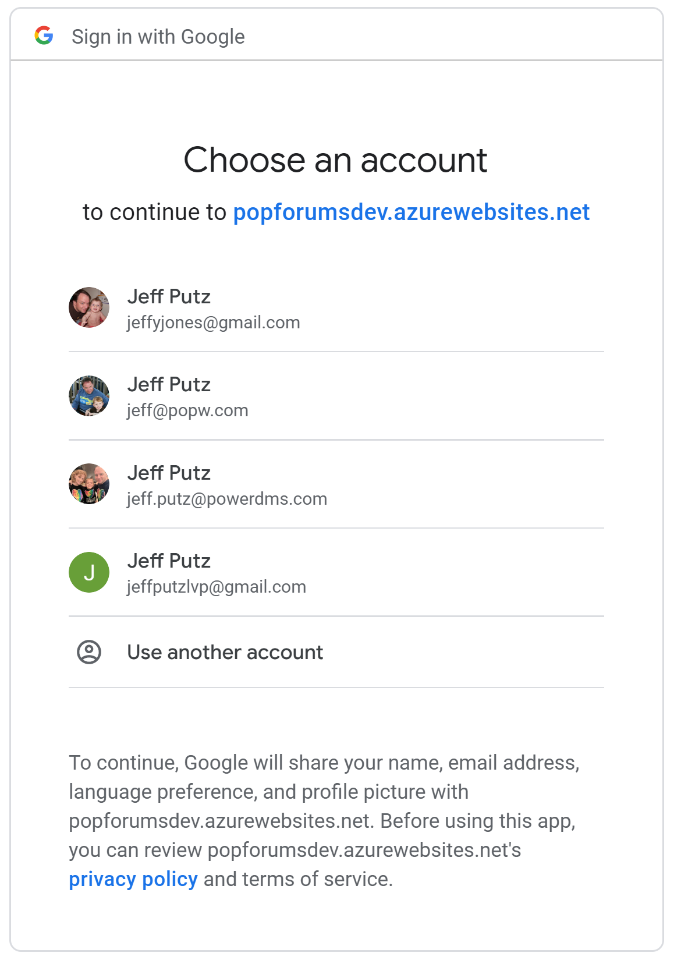
Digging in to OAuth2
Do what the identity provider asks you to do, authenticating and granting the calling service permission to access your identity. This is the consent mechanism.

Slide 15
Digging in to OAuth2
Identity provider redirects you back to the registered URI you gave it. It has:
state: As you sent it.
code: Which you’ll need to interrogate Google for the real data you’re after.
https://localhost:44353/home/callbackgoogle?state=d69bfca9c5b7fc1f72e02aafb9b06c5323d69ff5781c9a4ad16b748fdf200668&code=4%2FvAF09b1A4OFH1lr5gItBVPz5NTXR9EA87EcyqEU4IYS7tSLhN7qWslNfiBR-2-QszmUA7ccyETi1n4KWdFYasEs&scope=email+profile+https%3A%2F%2Fwww.googleapis.com%2Fauth%2Fuserinfo.email+https%3A%2F%2Fwww.googleapis.com%2Fauth%2Fuserinfo.profile+openid&authuser=0&session_state=e500bb00980021564dbdc2b4044cb8a4fcd0f8fe..c7bb&prompt=consent

Slide 16
Digging in to OAuth2
From the server, you POST to Google with these nuggets:
code: The thing you just received in the redirect.
client_id: The thing you initially sent and got from the Google console.
client_secret: The other thing you got from the Google console.
redirect_uri: Yes, that thing again.
grant_type: “authorization_code”

Slide 17
Digging in to OAuth2
Google’s gift for your POST, if everything is good, is a chunky piece of JSON (id_token shortened, a lot).
{
"access_token": "ya29.Il-4BwtksY2etn_M03H_AT3T6zKowNNbPekswQ456PbxEhZ_HP8pQpG3irDLo5OS2rqk3mtqpLUIKTDnOnM7VfFfcPZTq0-shiGs4W9TSd_OcO6J6Pg0vGdP3bbqT2w-2w",
"expires_in": 3599,
"scope": "openid https://www.googleapis.com/auth/userinfo.profile https://www.googleapis.com/auth/userinfo.email",
"token_type": "Bearer",
"id_token": “……uSXTlGTkRO9W9EfS8SUeORbyJjMhroBMGiyK6j8ec9yQBYx5d74O8SjldAGRmcEFSNi5SFDl_hNqGE_K3gX2kCWQYVH3CXzP1j4WGPMCGUn-jPQ"
}

Slide 18
Digging in to OAuth2
Data found in the JWT, which is parsed by libraries from your platform:
id: 107985981237398839587
name: Jeff Putz
email: jeff@popw.com
given_name: Jeff
family_name: Putz
picture: https://lh3.googleusercontent.com/a-/AAuE7mB_E92FdszIrNQSsxI5GHuGAih9HAH03W1s9cp1xw=s96-c

Slide 19
DEMO

Slide 20
Identity provider: to build or not
There is no magic formula to answer this question. A rigorous opportunity assessment is a good start.
Do you have the people qualified to do it? Are they expensive?
What protocols do you need to support?
What compliance standards are you subject to?
Are you invested in any technologies currently?
What does your user model look like? Are you B2B? B2C? Multi-tenant?

Slide 21

ID EXPERT

Slide 22
The 5 levels of identity hell
Writing everything from scratch
Lego blocks with no instructions (AWS Cognito)
Identity construction kit (open source, like Identity Server 4)
Third-party, but “on premise” (i.e., in your VPC)
Third-party, cloud-based providers (Auth0, Okta, Ping, AzureAD)

Slide 23
Rolling your own
Pros
Build it for exactly your use case
Host it any way you like
Tight control over compliance issues
Appeals to people who want to reinvent everything
Cons
You’re not a giant company who specializes in identity management
Larger liability surface area
Supporting it (if you need to configure external customers) is expensive
Appeals to people who want to reinvent everything

Slide 24
Using a 3rd party
Pros
Like most cloud infrastructure, it requires less expertise and maintenance
Leverage expertise of companies that do this for a living
Less liability surface area
Leaves you time to focus on your core compentencies
Cons
Less control over data
May not meet compliance needs (HIPPA, SOC2, CJIS, etc.)
Solution might not fit your use case well (dynamic provisioning, multi-tenancy, etc.)

Slide 25
Q&A
Please check-in and do the survey on the CodeMash app
Also send love or hate mail directly jeff@popw.com
jeffputz jeffputz jeff.putz

